Slide 1
Beyond Image Classification
Notes:
While Jetson is installing files, move into this discussion.

Slide 2
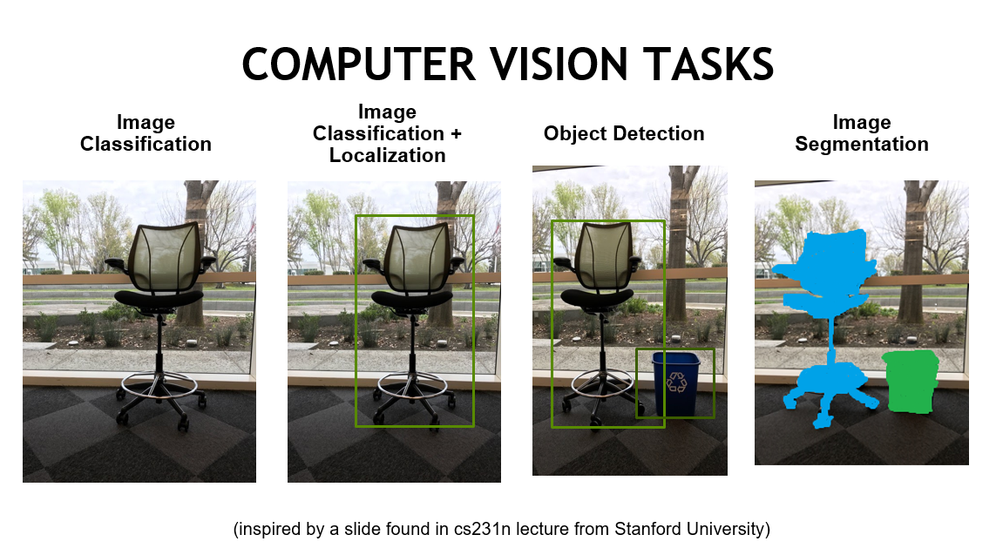

Slide 3
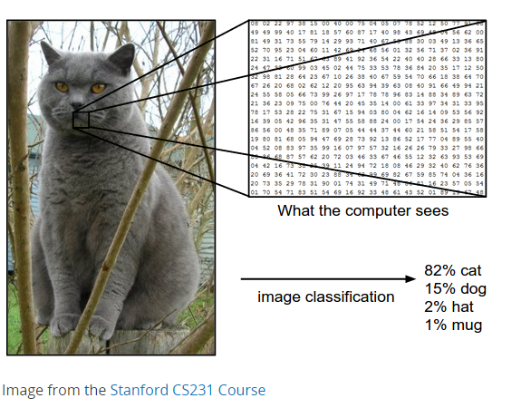
Inputs and Outputs

Slide 4
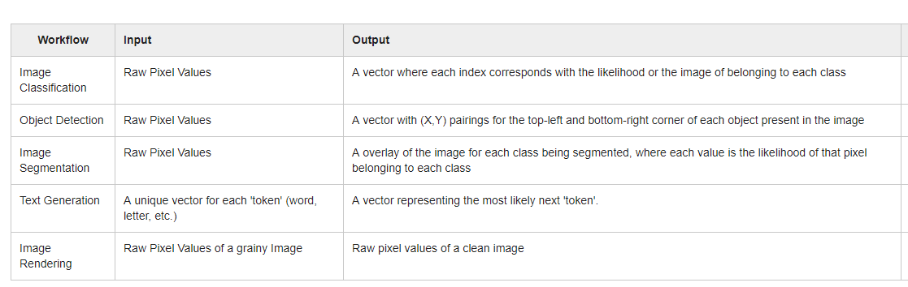
Inputs and Outputs

Slide 5
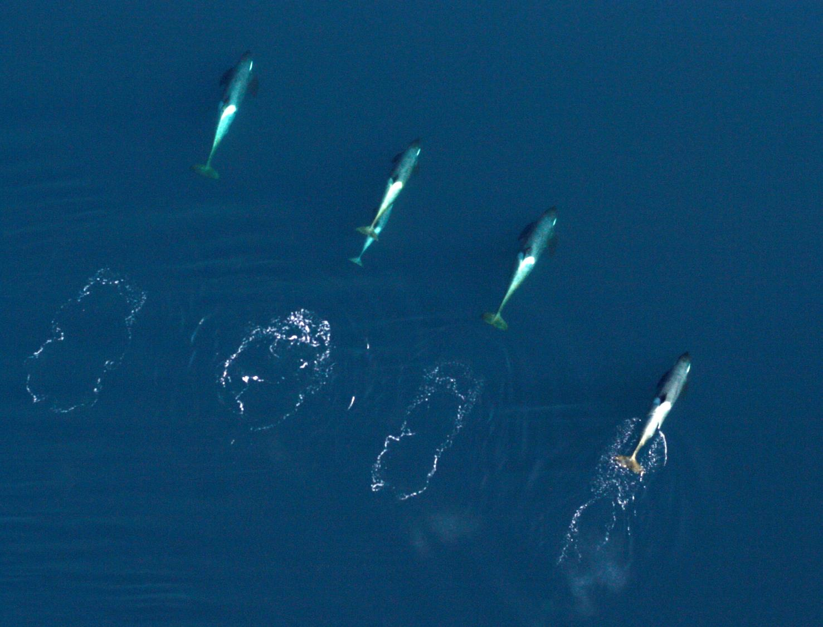
Object Detection
Finding a whale face in the ocean.
We want to know IF there are whale faces in aerial images, and if so, where.
Notes:
There are two main categories to the benefits of AI.
Doing work so we don’t have to.
Doing work that it is better suited to than we are.
This challenge is among the former. Large scale “searching” and “localizing” can be incredibly tedious. Shouldn’t we ‘hire’ AI for help?

Slide 6
Next Page:
How can we use what we know about Image Classification to detect whale faces from aerial images?
Take 2 minutes to think through and write down (paper or computer) ideas.
Notes:
Have the class brainstorm how they might approach the problem. Set aside some amount of time (as close to 2 full minutes as possible) for quiet reflection. Have people share with neighbors, whole class, etc. Without judgement of correct answers (there are many correct answers), share that we are going to solve it in ONE possible way.

Slide 7
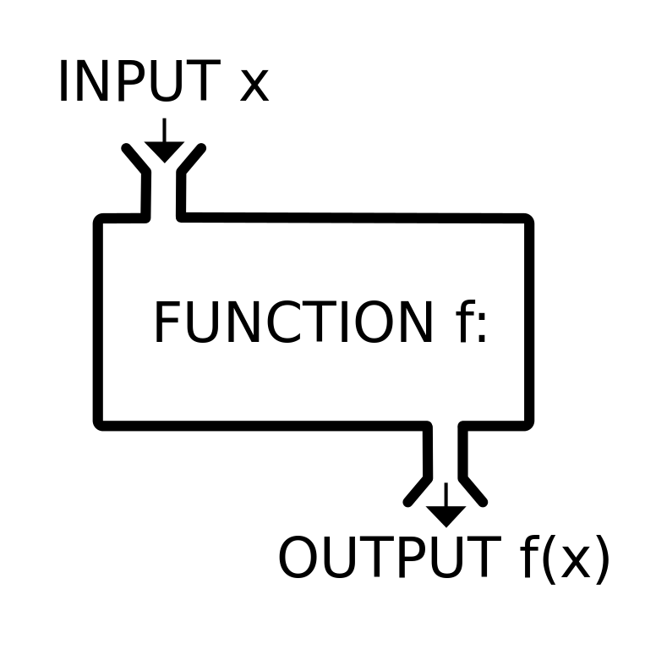
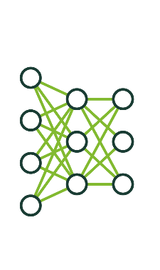
AI at scale
Solving novel problems with code
Applications that combine trained networks with code can create new capabilities
Trained networks play the role of functions
Building applications requires writing code to generate expected inputs and useful outputs

Slide 8
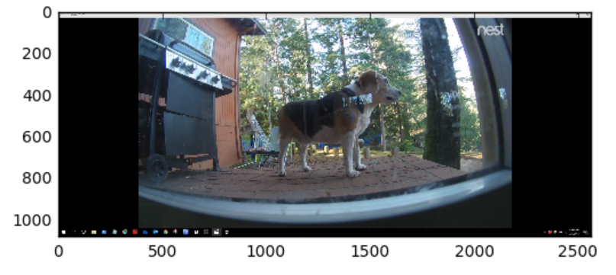
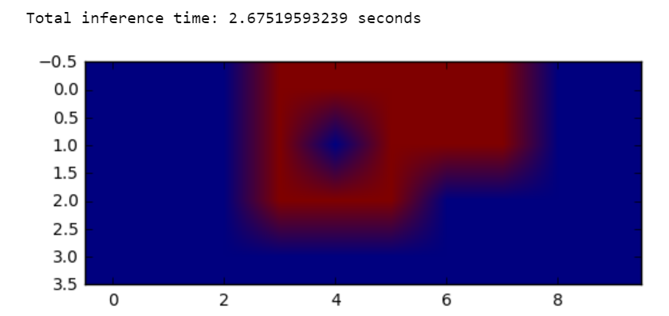
Approach 1: Sliding Window
Technique:
Build a dog/’not dog’ classifier
Sliding window python application runs classifier on each 256X256 segment
Notes:
We’re going to first train a whale face/not whale face classifier. This is a great opportunity to test whether you recall how to train an image classification model given a dataset using DIGITS. Note, there are pre-loaded datasets and models in this lab. You’ll use those later. Here, you’re starting from scratch with a directory full of whale faces and non whale faces.
Next, you’ll deploy your classifier to a python application that crops the aerial image into 256X256 grid squares. When that classifier indicates a prediction of “whale face”, your program will output a blue square, when “not whale face”, your program will output a red square.
The key takeaway is that you can combine deep learning capabilities with traditional programming to deploy your capability at scale.

Slide 9
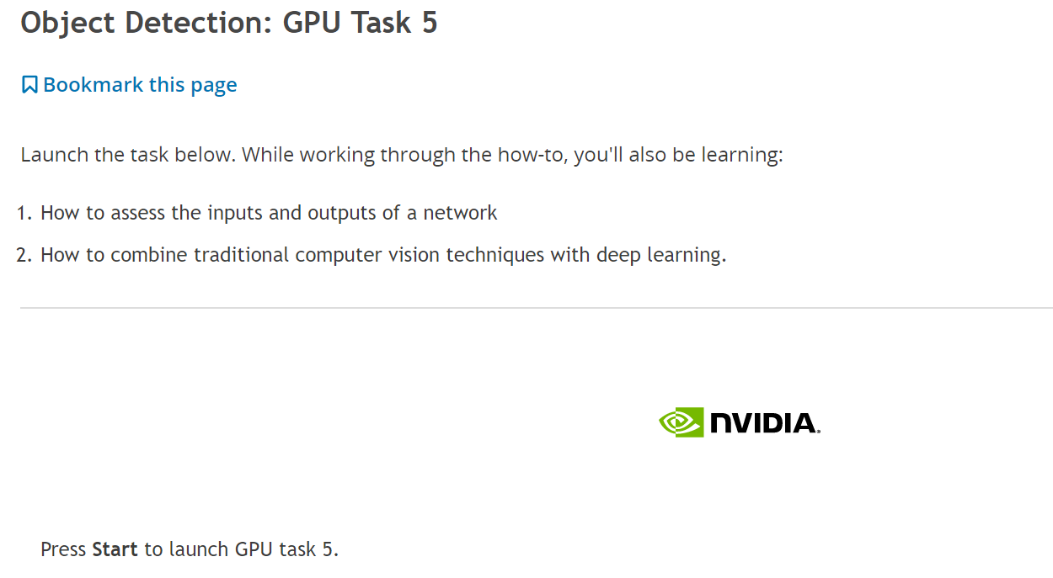
Next Page

Slide 10
Approach 1: Sliding Window
Works but:
Needs human supervision
Slow – constrained by image size
Notes:
When most of the class has run their first inference, bring them together.
By now you’ve created your first object detector. Notice that that the skills needed to succeed here were identifying the expected input and generated output of your model, knowing how to deploy a neural network (taught in depth in our next lab), and any programming prowess you have. To thrive, we’d need to work to identify which images our detector handles well and which it doesn’t and then diagnose why. We could work for a lifetime (domain experts have) to balance throughput with accuracy, or we could learn a little more about DL to create a better match between our problem and our solution.

Slide 11
Discuss: Intro to Network architecture

Slide 12
Approach 2 – Modifying Network Architecture
Layers are mathematical operations on tensors (Matrices, vectors, etc.)
Layers are combined to describe the architecture of a neural network
Modifications to network architecture impact capability and performance
Each framework has a different syntax for describing architectures
Regardless of framework: The output of each layer must fit the input of the next layer.
Notes:
The more of our problem we solve with a learned function, the more we get to take advantage of machine learning, and usually, the higher performance we obtain. Since we’ve identified the input image size as a limitation of our current approach, we can experiment with network architecture to remove that constraint.
Our “architecture” is a description of all math from input to output of our network, so by changing the architecture, we’re changing the math.
We can perform almost endless experimentation with our networks by changing their descriptions with whatever framework we’re working in, limited by one hard constraint….The data must flow. The output of each layer must fit the input of the next. Let’s look at how data flows in the network as it’s architected currently.

Slide 13
CAFFE FEATURES
Deep Learning model definition
Protobuf model format
Strongly typed format
Human readable
Auto-generates and checks Caffe code
Developed by Google, currently managed by Facebook
Used to define network architecture and training parameters
No coding required!
name: “conv1”
type: “Convolution”
bottom: “data”
top: “conv1”
convolution_param {
num_output: 20
kernel_size: 3
stride: 1
weight_filler {
type: “xavier”
}
}
Notes:
The example on the right is a layer. In the layer, the Protobuf language defines:
The type of layer (In this case a Convolutional Layer
May want to tie this back to an earlier slide on convolution
The labels bottom: and top: indicate how this layer is connected to other layers
The Param section allows you to specify more specifics of this layer
Xavier = Xavier Initialization for parameters (weights)

Slide 14

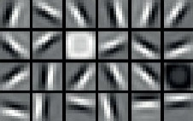
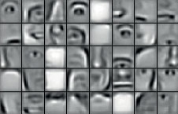
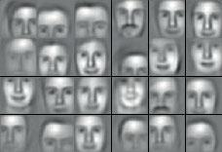
Image Classification Network (CNN)
Raw data
Low-level features
Mid-level features
High-level features
Application components:
Task objective
e.g. Identify face
Training data
10-100M images
Network architecture
~10s-100s of layers
1B parameters
Learning algorithm
~30 Exaflops
1-30 GPU days
Input
Result
Notes:
This is an abstracted view of a network like AlexNet. It’s specifically designed to learn to classify images. It can learn to recognize handwritten digits, whale faces, or tumors.
The first 5 layers are “convolutional layers.” There is an introduction to the math of a “convolution” in the lab, but at a high-level, each layer learns higher and higher level features.
The last three are “fully-connected layers.” These do traditional matrix multiplication. These are the most generalized learning layers used in deep learning, meaning they are not designed to learn something specific, but continue learning and change the shape of data to generate a desired output step.
One constraint of “fully-connected layers” is that they require specific input sizes. The next section of the lab will guide you through the replacement of these layers with convolutional layers, creating a (Fully Convolutional Network) that can take as input images of any size!
This task is just one of many that you could try to change the behavior of your network. The challenge in this section is in rearranging a network where data still flows.
In this example of facial identification, the network has several hidden layers.
The first hidden layers detect low level features, often edges or circles
As data move through the network, mid-level features are extracted from subsequent layers. The mid-level features can be eyes, mouths or noses
High-level features are composites of different faces that have been passed through the network
Networks like this can have the following properties
Be trained with tens or hundreds of millions of images
The network can consists of tens to hundreds of layers with millions or even billions of weights
Training large networks can often days or weeks.

Slide 15
CONVOLUTION
Center element of the kernel is placed over the source pixel. The source pixel is then replaced with a weighted sum of itself and nearby pixels.
0
0
0
0
0
0
1
0
0
0
1
0
1
2
1
1
0
1
2
0
2
2
1
0
1
2
0
2
1
0
0
1
2
2
0
4
Source Pixel
0
1
1
0
0
0
1
0
0
0
1
1
0
-4
0
1
1
0
0
1
0
-8
0
1
0
Convolution kernel (a.k.a. filter)
New pixel value (destination pixel)
Notes:
In Deep Learning, there are many different ways to construction a layer. One of the most important techniques is a convolutional neural network. A convolution neural network applies a small kernel to a patch of the input data. Applying kernels like this are much less computationally intensive than a fully connected network.
Kernel = filter = matrix (typically small)
Dot production calculation is performed between convolution (filter) and source pixels
Result is stored in an activation map
This convolution example is shown here in 2D but can be done in any amount of dimensions.
We have a convolution kernel in the center, to transform the source image.
At each location we do a pair wise multiplication of the kernel and the source values and sum these together to get the destination value.
Source Left: http://www.biomachina.org/courses/structures/01.html
Source Right: http://www.westworld.be

Slide 16
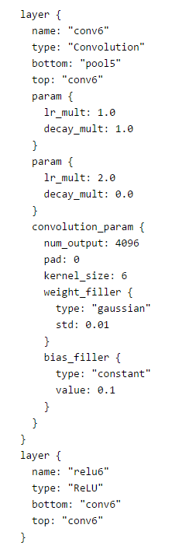
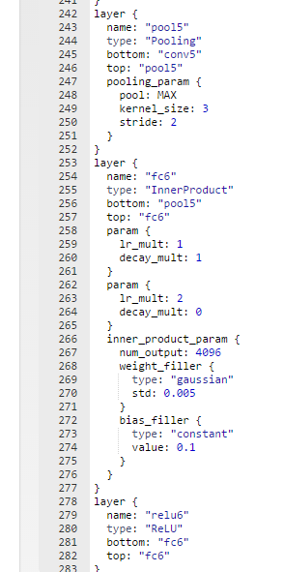
APPROACH 2 – Network Modification
Approach :
Change the structure of the network
FC = Fully Connected = Matrix Multiplication = Size Constraint
Notes:
You’re going to edit the network definition file using DIGITS. Work through the lab instructions to see how your changes impact the network, what changes retain functionality, and how to assess performance increase.

Slide 17
Back to lab
Replace layers by reading carefully
Ask for help if you need
Continue through end of lab
We’ll discuss “Detectnet” post-lab

Slide 18
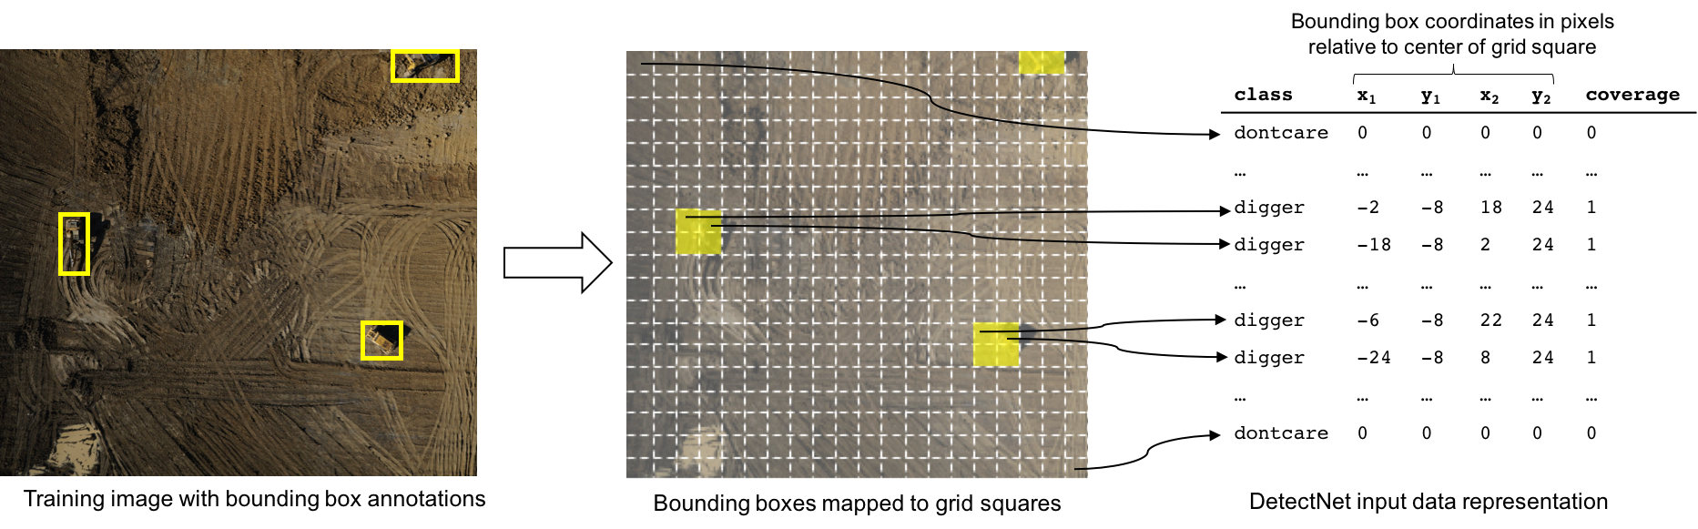
Approach 3: End-to-End Solution
Need dataset with inputs and corresponding (often complex) output
Notes:
Ideally, you handle the entire problem with a purpose built network. This requires:
1) Creating a dataset of inputs and their corresponding outputs
The main challenge in training a single CNN for object detection and bounding box regression is in handling the fact that there can be varying numbers of objects present in different images.
In some cases you may even have an image with no objects at all.
DetectNet handles this problem by converting an image with a number of bounding box annotations to a fixed dimensionality data representation that we directly attempt to predict with a CNN.
Figure above shows how data is mapped to this representation for a single class object detection problem.

Slide 19
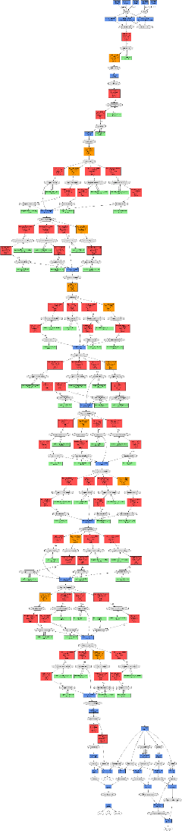
Approach 3 – End to end solution
High-performing neural network architectures require deep experimentation
You can benefit from the work of the community through the modelzoo of each framework
Implementing a new network requires an understanding of data and training expectations.
Find projects similar to your project as starting points.

Slide 20
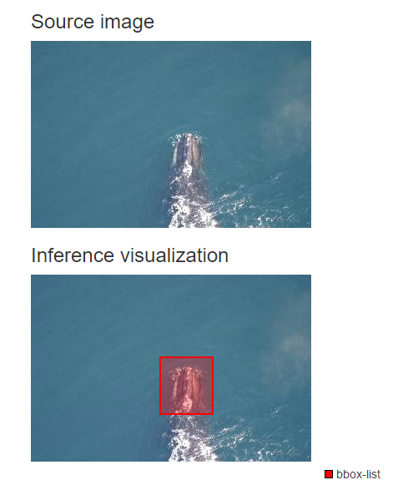
Approach 3: End-to-End Solution
DetectNet:
Like AlexNet, DetectNet is optimized for a certain type of learning, but is generalizable to multiple contexts.
Notes:
Dog-detectnet, pedestrian detectnet

Slide 21
Closing thoughts – Creating new functionality
Approach 1: Combining DL with programming
Scaling models programmatically to create new functionality
Approach 2: Experiment with network architecture
Study the math of neural networks to create new functionality
Approach 3: Identify similar solutions
Study existing solutions to implement new functionality

Slide 22
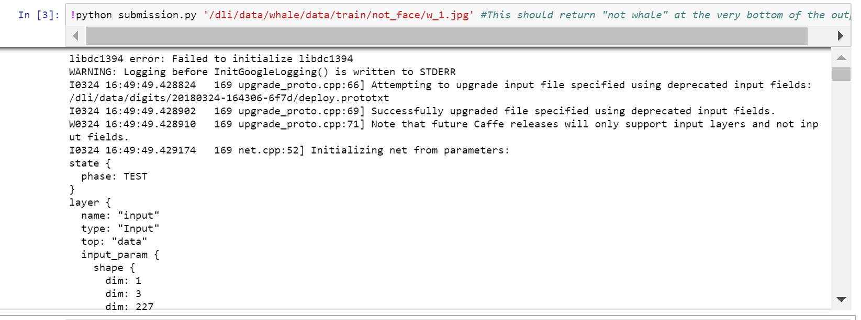

Slide 24
